Slide 1
PRESENTATION: L1M4

Slide 2
Content Of Table
Task1: Water Jug problem
Task2: Missionaries and Cannibals problem
Task4: Technical Debt
Task4: Graph Algorithms
Task5: How to automate business processes

Slide 3
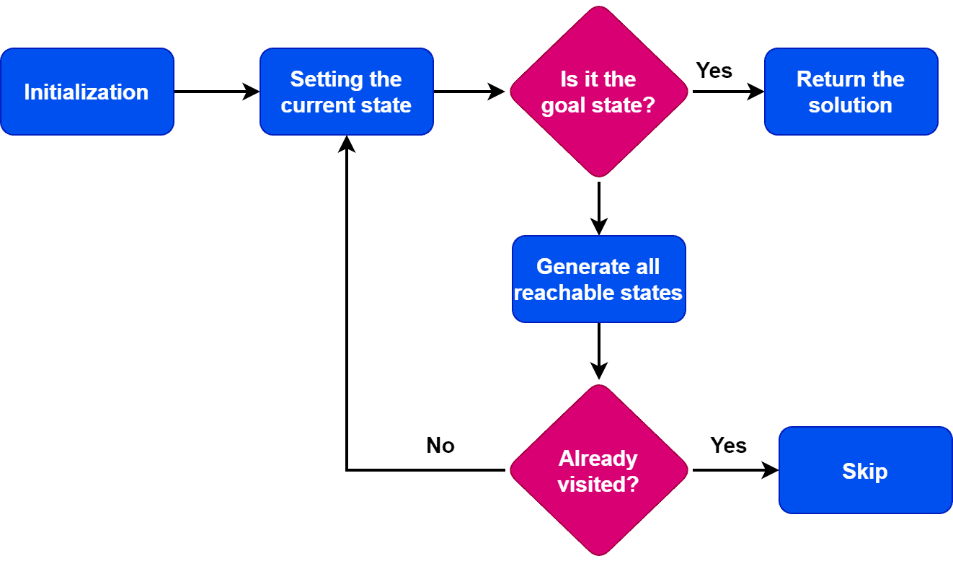
What Is State Space Search?
State: A specific configuration of the problem.
Initial State: The starting point of the search.
Goal State: The desired end configuration.
Transition: An action that changes one state to another.
Path: A sequence of states connected by transitions.
Search Strategy: The method used to explore the state space.

Slide 4
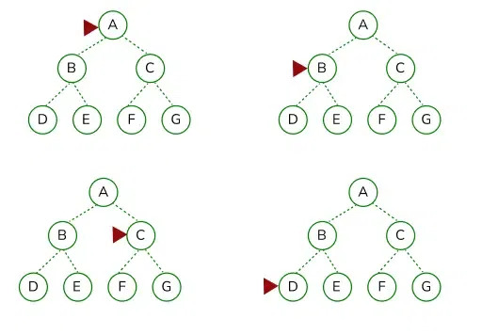
BFS
Time Complexcity:-
BFS visits all the vertices at each level of the graph before moving to the next level.
In the worst case BFS may visit all vertices and edges in the graph so TC is O(V+E).
Space Complexcity:-
In the worst case, if the graph is a complete graph, all vertices at each level will be stored in the queue.
Therefore, the space complexity of BFS is O(V), where V represents the number of vertices in the graph.

Slide 5
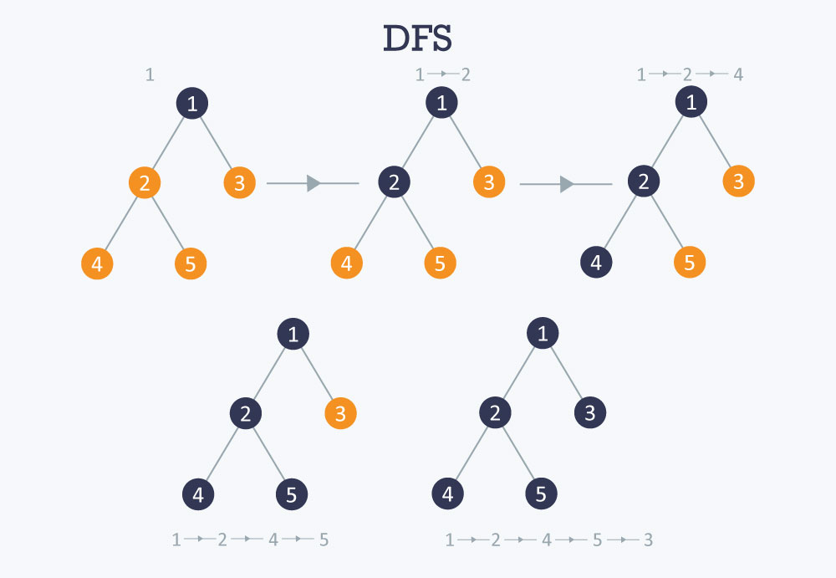
DFS
Time Complexcity:-
For each vertex, DFS visits all its adjacent vertices recursively.
In the worst case DFS may visit all vertices and edges in the graph so TC is O(V+E).
Space Complexcity:-
In the worst case, if the graph is a straight line or a long path, the DFS recursion can go as deep as the number of vertices.
Therefore, the space complexity of BFS is O(V)

Slide 6
Water Jug problem
Understanding The Problem:
In starting jugs is empty
Can fill the jug with full capacity
Can empty the jug
And transfer the water from one jug to another jug
Goal:- need to measure the given quantity of water

Slide 7
Workflow And Algorithm
State:- Quantity of water in jugs
There are six possible operations that can be applied at any given state:
1- Fill Jug 1: Fill the first jug to its maximum capacity (m liters).
2- Fill Jug 2: Fill the first jug to its maximum capacity (n liters).
3-Empty Jug 1: Completely empty the first jug.
4-Empty Jug 2: Completely empty the second jug.
5-Pour Jug 1 into Jug 2: Pour as much water as possible from the first jug into the second jug until the second jug is full or the first jug is empty.
6- Pour Jug 2 into Jug 1: Pour as much water as possible from the second jug into the first jug until the second jug is full or the second jug is empty.
Solution using the State Space Search and Searching strategy is BFS.

Slide 8
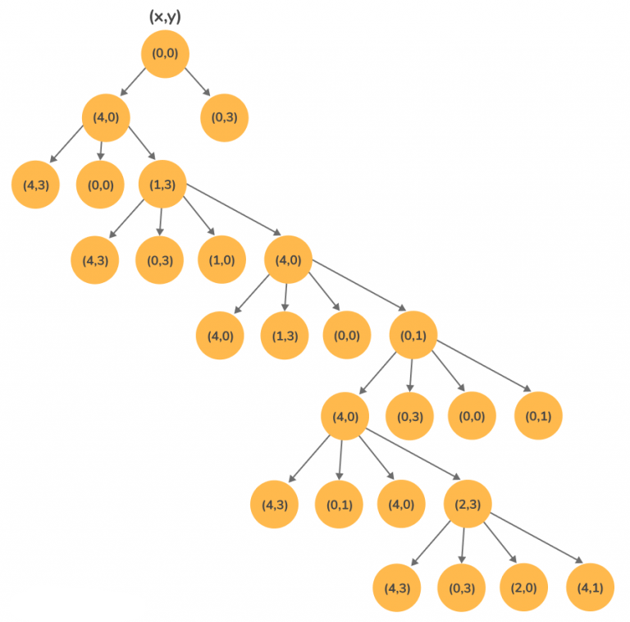
Example: L_jug=4L,d=2L,S_jug=3L

Slide 9
Time And Space Complexcity
Time Complexity:
The algorithm performs Breadth-First Search (BFS) on all possible water levels of the two jugs.
The number of unique states is (m+1) × (n+1) since each jug can hold from 0 to m and 0 to n liters.
Each state generates at most 6 possible transitions (fill, empty, or pour operations).
Since BFS processes each state once, the time complexity is: O(m × n).
Space Complexity:
The visited array requires O(m × n) space to track visited states.
The queue in BFS can hold up to O(m × n) elements in the worst case.
Hence, the space complexity is: O(m × n).

Slide 10
Missionaries and Cannibals problem
Understanding the problem:-
Boat can hold only two persion.
Boat will not travel itself.
At any bank if number of cannibals is greater than missionaries then you lost.
Approach:-
Using graph where state reprents
{ mleft,cleft, mright, cright boat_position ,parent }
Then apply BFS to find the desired ,goal state

Slide 11
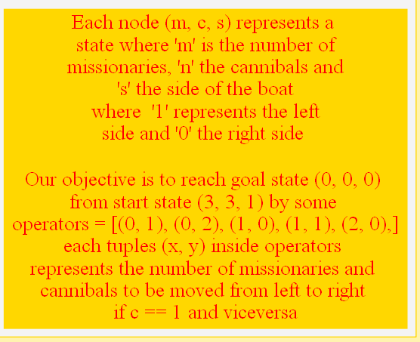

Slide 12
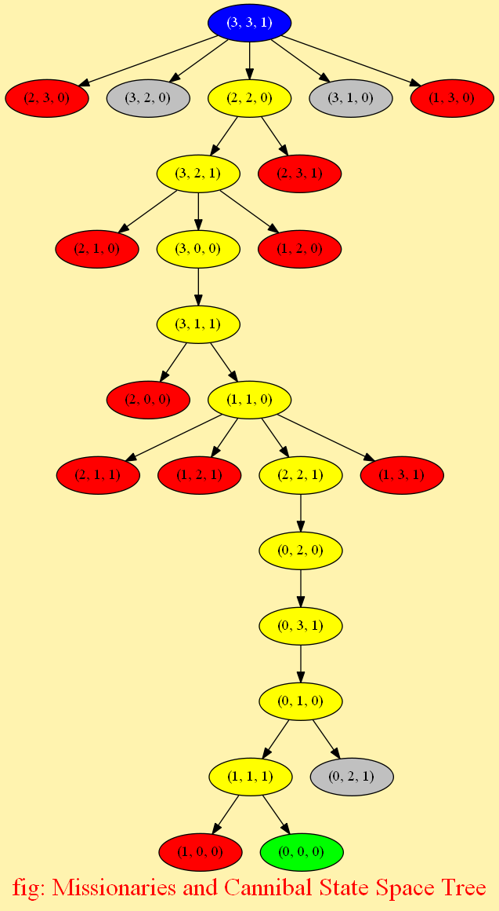
Workflow And Algorithm

Slide 13
Time And Space Complexcity
1. Time Complexity: O(V + E)
V (States/Vertices):
Each state is represented as (ML, CL, MR, CR, BoatPosition).
The total number of possible states is (M+1) × (C+1) × 2, as each count ranges from 0 to M or C, and the boat can be on either side.
In the worst case, V ≈ O(M × C).
Space Complexity: O(V)
Queue Storage (BFS):
In the worst case, all valid states need to be stored in memory, so O(V) = O(M × C).
Visited Map:
We store all visited states to avoid re-exploring, contributing another O(V).
Overall Space Complexity:
Worst case: O(M×C)O(M \times C)O(M×C)

Slide 14
Technical Debt
What is Technical Debt & Types
Definition: Technical Debt refers to the implied cost of additional rework caused by choosing a quick or suboptimal solution instead of a more efficient and maintainable one. It occurs when developers prioritize speed over quality, leading to long-term inefficiencies.
Types of Technical Debt:
Planned Debt: Intentional shortcuts taken to meet deadlines.
Unintentional Debt: Caused by poor design, lack of skills, or evolving requirements.
Code Debt: Poorly written code that is difficult to maintain.
Design Debt: Architectural flaws that complicate future changes.
Testing Debt: Insufficient test coverage leading to bugs.
Documentation Debt: Lack of proper documentation, making onboarding difficult.

Slide 15
Measuring Technical Debt
Code Quality Metrics:
Cyclomatic Complexity: Measures code complexity.
Code Duplication: Increases maintenance overhead.
Code Smells: Poor coding practices like large classes or long functions.
Code Churn: Frequent code changes may signal instability.
Technical Debt Ratio (TDR):
Formula: TDR = (Remediation Cost / Development Cost) * 100.
Remediation cost: Time to fix debt, Development cost: Time spent on existing code.
Maintainability Index:
A score (0-100) to assess how easy the code is to maintain.
Subjective Assessments:
Code Reviews and Developer Surveys for feedback on code maintainability.

Slide 16
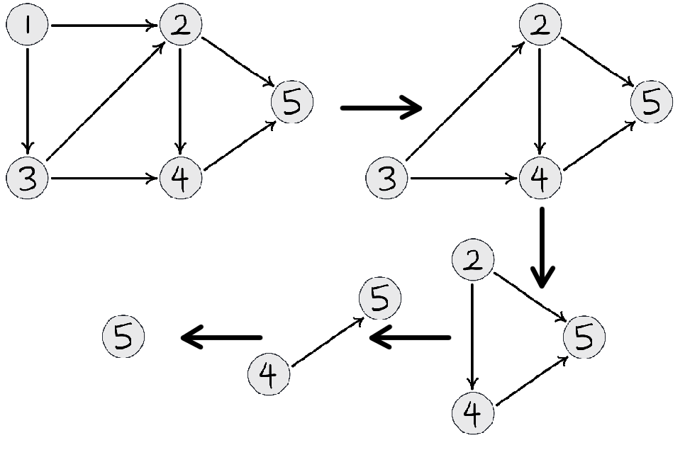
Graph Algorithms
Topological Sorting:- Topological sorting is a dependency problem in which completion of one task depends upon the completion of several other tasks whose order can vary.
If there is an edge {u,v} from vertex u to v then u will come before v.
And this algorithm is appicable for only DAG(Directed Acyclic Graph).
In DFS, recursively call DFS for its adjacent vertices. In TS print a vertex before its adjacent vertices.

Slide 17
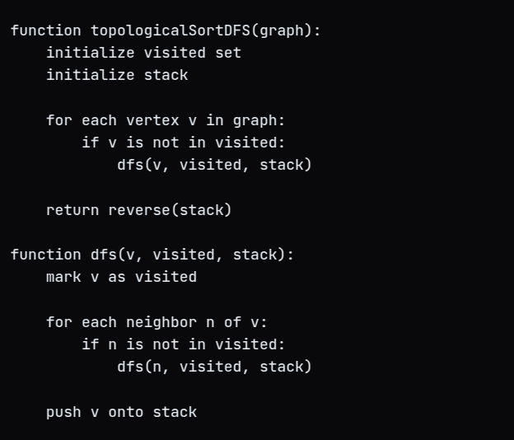
Topological Algorithm
Time Complexity: in worst case have to travers all the vertex and edges so TC is O(V+E).
Space Complexity:- Need to store status so Space Complexity is O(V).

Slide 18
Dijkstra’s algorithm
Dijkstra’s Algorithm finds the shortest path from a single source node to all other nodes in a weighted graph with non-negative edge weights.
Key Features:
Uses a greedy approach
Works on directed and undirected graphs
Time Complexity: O((V+E)log⁡V) using a priority queue
Applications:
Finding shortest routes in maps
Network routing optimization

Slide 19
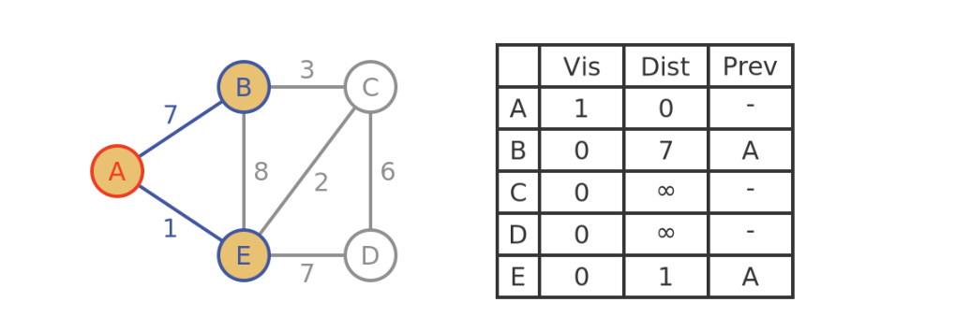
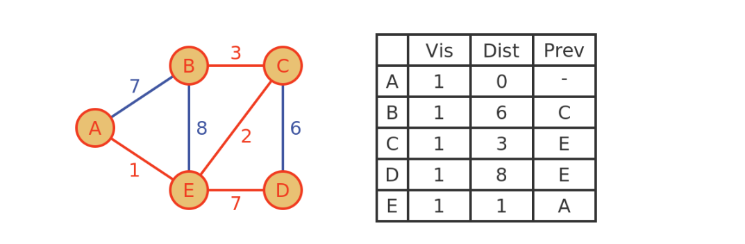
Dijkstra’s algorithm
Example:-How Algorithm works

Slide 20
Introduction to Business Process Automation
What is Business Process Automation (BPA)?
The use of technology to perform repetitive tasks, streamline workflows, and improve efficiency.
Why Automate?
Saves time & reduces errors
Increases productivity
Enhances customer experience
Common Areas for Automation:
Data Entry & Processing
Invoice & Payment Processing
Customer Support (Chatbots)
Report Generation

Slide 21
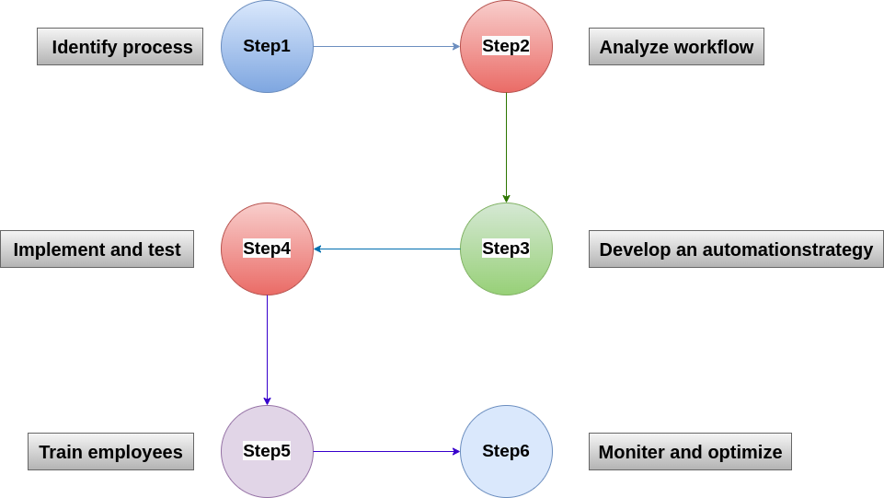
Steps to Automate Business Processes

Slide 22
Steps to Automate Business Processes
Identify Processes: Find repetitive, manual tasks that consume significant time and effort.
Analyze Workflow: Understand how tasks currently flow, identify inefficiencies, and determine where
Develop an Automation Strategy: Clearly define automation goals, key performance indicators (KPIs),
Implement & Test: Start with a small pilot project to validate the automation approach. Gather feedback
Train Employees: Educate employees on new automation processes, provide necessary training, and
Monitor & Optimize: Continuously track the performance of automated processes, gather insights, and

Slide 23
Thank You

